Slide 1


More adapted species have higher disorder in vertebrate protein domains
NASA Space Grant Symposium 2021
Catherine Weibel
Masel Lab
Notes:
Hi!
I’m going to present some of the work I’ve been doing, focused on how biophysical protein dynamics impact molecular evolution.

Slide 2
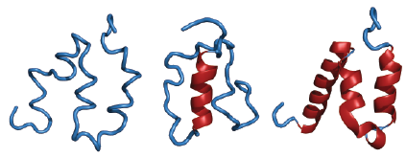
Proteins have a range of conformational freedom
ISD Linked with:
Protein misfolding
Avoiding protein aggregation
Diversification of protein structures
Intrinsic Structural Disorder (ISD)
ISD calculated using IUPred2
Takes Amino Acid sequences
Estimates number possible conformational states
Disordered
Ordered
Notes:
Most of my work in the Masel lab has focused on protein structural disorder, or proteins’ general degree of tanglyness verses clear structure.
In general, protein structural disorder helps avoid clumping, but also impedes the efficacy of protein folding.
The balance between these two selective pressures might vary among species due to differences between species’ ability to get rid of harmful mutations - which I refer to as a species’ adaptedness.

Slide 3
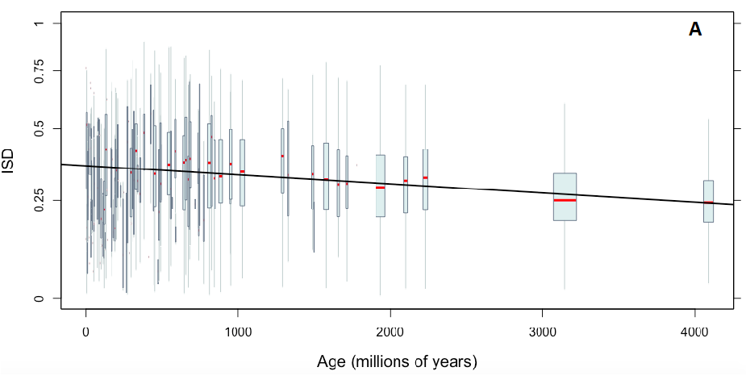
Long term trends in protein evolution can’t be driven by differences in species-level selection
Old protein domains have lower ISD than young domains
ISD
Expectation: species with more effective selection have less disordered protein domains
Age (millions of years)
James et al., 2020 Preprint
Notes:
Past work in the Masel lab suggests that protein domains (the evolutionary LEGO bricks of proteins) become more structurally ordered with age. The burning question is: why? Shouldn’t disorder generally be more deleterious, and be selected against over time?
Measuring “selection” across timescales by itself is difficult, so for now, I’ve been working to answer the question: just how does selection act on protein disorder, looking specifically at modern vertebrate species?
To approach any of this, I had to figure out how to quantify two things: individual species’ adaptedness, and the general level of domain disorder in individual species-

Slide 4
How do we measure selection?
Effectiveness of selection is reflected in codon usage
AGC
AGT
AGC
AGT
TCT
TCC
TCA
TCT
TCG
TCA
No codon adaptation
High codon adaptation
Notes:
First: I needed to come up with a way to measure species’ adaptedness. Fortunately, “adaptedness” is reflected in patterns of synonymous codon usage, or in the preferences of using one codon to code for an amino acid over others.
For example, there are six codons that, when translated, create the amino acid serine. In a species that isn’t particularly choosy, the six codons are used at roughly equal frequencies, whereas in a more adapted species, there are clear preferences of a particular codon or codons for making serine.
There are existing metrics that quantify effectiveness of selection, such as Effective Number of Codons and Codon Adaptation Index, but they’re all designed for comparison of adaptation between genes within the same genome.

Slide 5
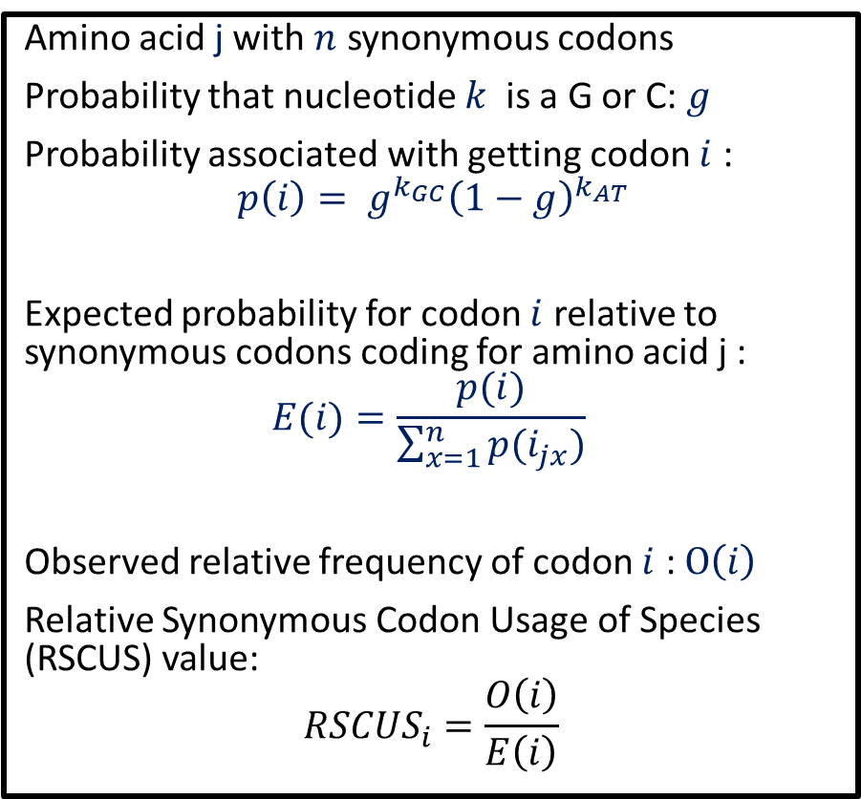
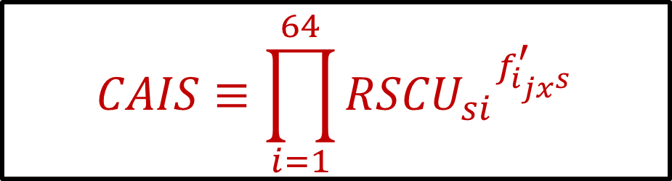
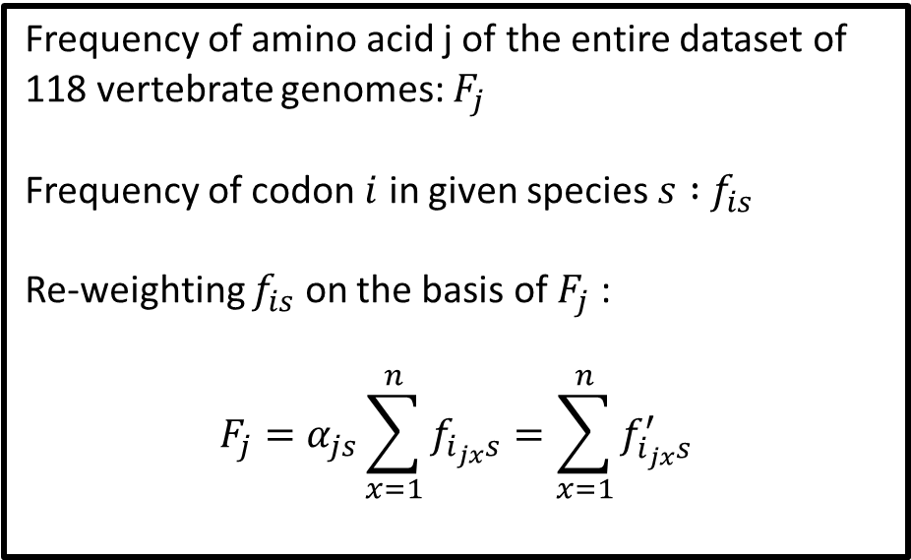
We came up with a new metric:
Codon Adaptation Index of Species (CAIS)
Amino acid j with $n$ synonymous codons
Probability that nucleotide $k$ is a G or C: $g$
Probability associated with getting codon $i$ :
$$p\left(i\right)= g^{k_{GC}}{\left(1−g\right)}^{k_{AT}}$$
Expected probability for codon $i$ relative to synonymous codons coding for amino acid j :
$$E(i)=\frac{p(i)}{\sum_{x=1}^{n}{p(i_{jx})}}$$
Observed relative frequency of codon $i$ : $O\left(i\right)$
Relative Synonymous Codon Usage of Species (RSCUS) value:
$${RSCUS}_{i}=\frac{O\left(i\right)}{E\left(i\right)}$$
Frequency of amino acid j of the entire dataset of 118 vertebrate genomes: $F_{j}$
Frequency of codon $i$ in given species $s :$ $f_{is}$
Re-weighting $f_{is}$ on the basis of $F_{j}$ :
$$F_{j}=α_{js}\sum_{x=1}^{n}{f_{i_{jx}s}}=\sum_{x=1}^{n}{f_{i_{jx}s}^{′}}$$
$$CAIS≡\prod_{i=1}^{64}{{{RSCU}_{si}}^{f_{i_{jx}s}^{′}}}$$
Notes:
I developed a new metric, Codon Adaptation Index of Species (CAIS). Like the other metrics, CAIS measures synonymous codon usage from gene-coding sequences, but really what makes it novel is that it’s corrected for total genomic GC content, and amino acid composition. These two corrections make CAIS values comparable across species, not just within.

Slide 6
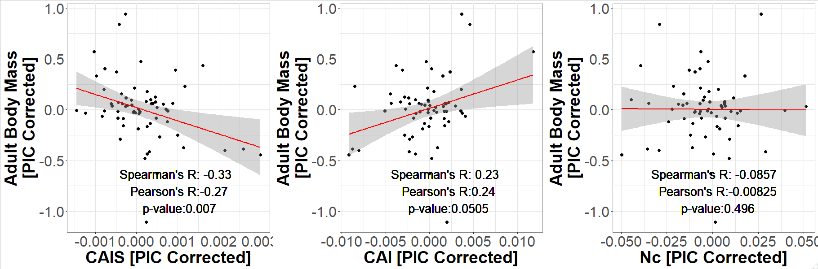
CAIS is comparable across species rather than within genomes
CAIS shows expected relationship:
more effectively selective species have smaller body size
AGC
AGT
TCA
TCT
Other commonly used metrics of codon usage fail to capture the expected relationship
Notes:
No previous metric has been able to capture the fundamental prediction from theoretical population genetics that more effectively selective species have smaller body size. For the first time, CAIS caught this relationship in vertebrates, a dataset with notoriously weak codon adaptation.

Slide 7
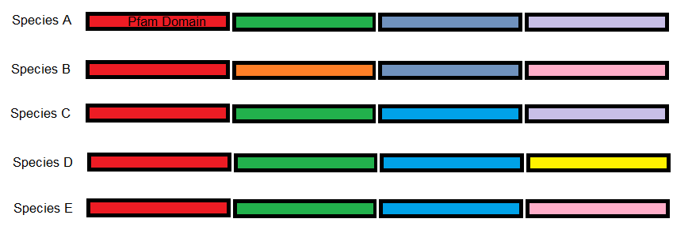
Different species have different protein domain compositions
Linear model with species as fixed effect and Pfam as random effect
Linear model with species as fixed effect and protein domains as random effect → Extract species effect on protein domain disorder
Notes:
Moving on to quantifying tanglyness. I couldn’t just take an average of a species’ domain disorder. The whole point of this project is to compare between species, and species all have different protein domain compositions. IE in the illustration, if we imagine different species’ genomes as made up of “chunks” of protein domains of different colors, not all species have the yellow or pink domains present. Averaging across an uneven playing field is flat-out unfair.
The other thing is that my conservatively sized dataset has 60 million annotated protein domains across 118 species, so some computational skullduggery was necessary-
To get around the computational complexities,I used mixed linear models, which fit a model to the relationship between predicted structural disorder and species, except with a random subgrouping parameter, to control for protein domain composition. From this, I could extract species effects on disorder (which are more statistically sound species-wide metrics that are comparable to each other.)

Slide 8
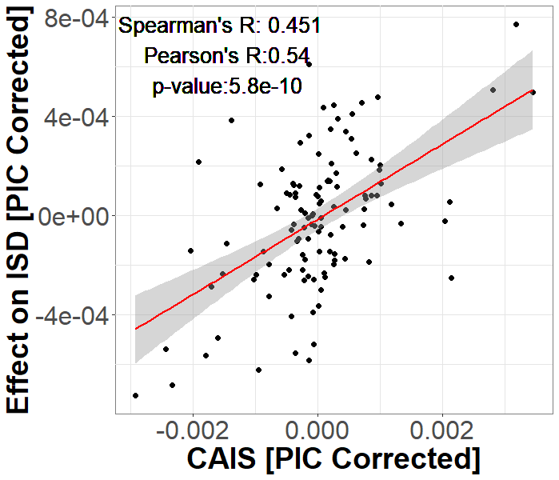
Well-adapted species have higher ISD
Additional results available in preprint Weibel et. al, 2020 (bioRxiv) https://doi.org/10.1101/2020.10.15.341313
Notes:
Using CAIS in conjunction with the species effects on disorder, I’ve found that well adapted vertebrate species have protein domains with more structural disorder than poorly adapted species.
This indicates that structural disorder is actually favored, contrary to all expectations. Perhaps the possibility of new, more disordered structures is worth the risk of protein dysfunction. I’m currently chasing this line of inquiry down with a cluster of other projects

Slide 9








Acknowledgments
Joanna Masel
Jennifer James
Luke Kosinski
Paul Nelson
Notes:
I’d like to thank everyone in the Masel Lab for their patience as I battled the lab server, UA HPC for their computation time, and the NASA Space Grant Internship Program for the opportunity to present.
Thank you for listening!

Slide 10
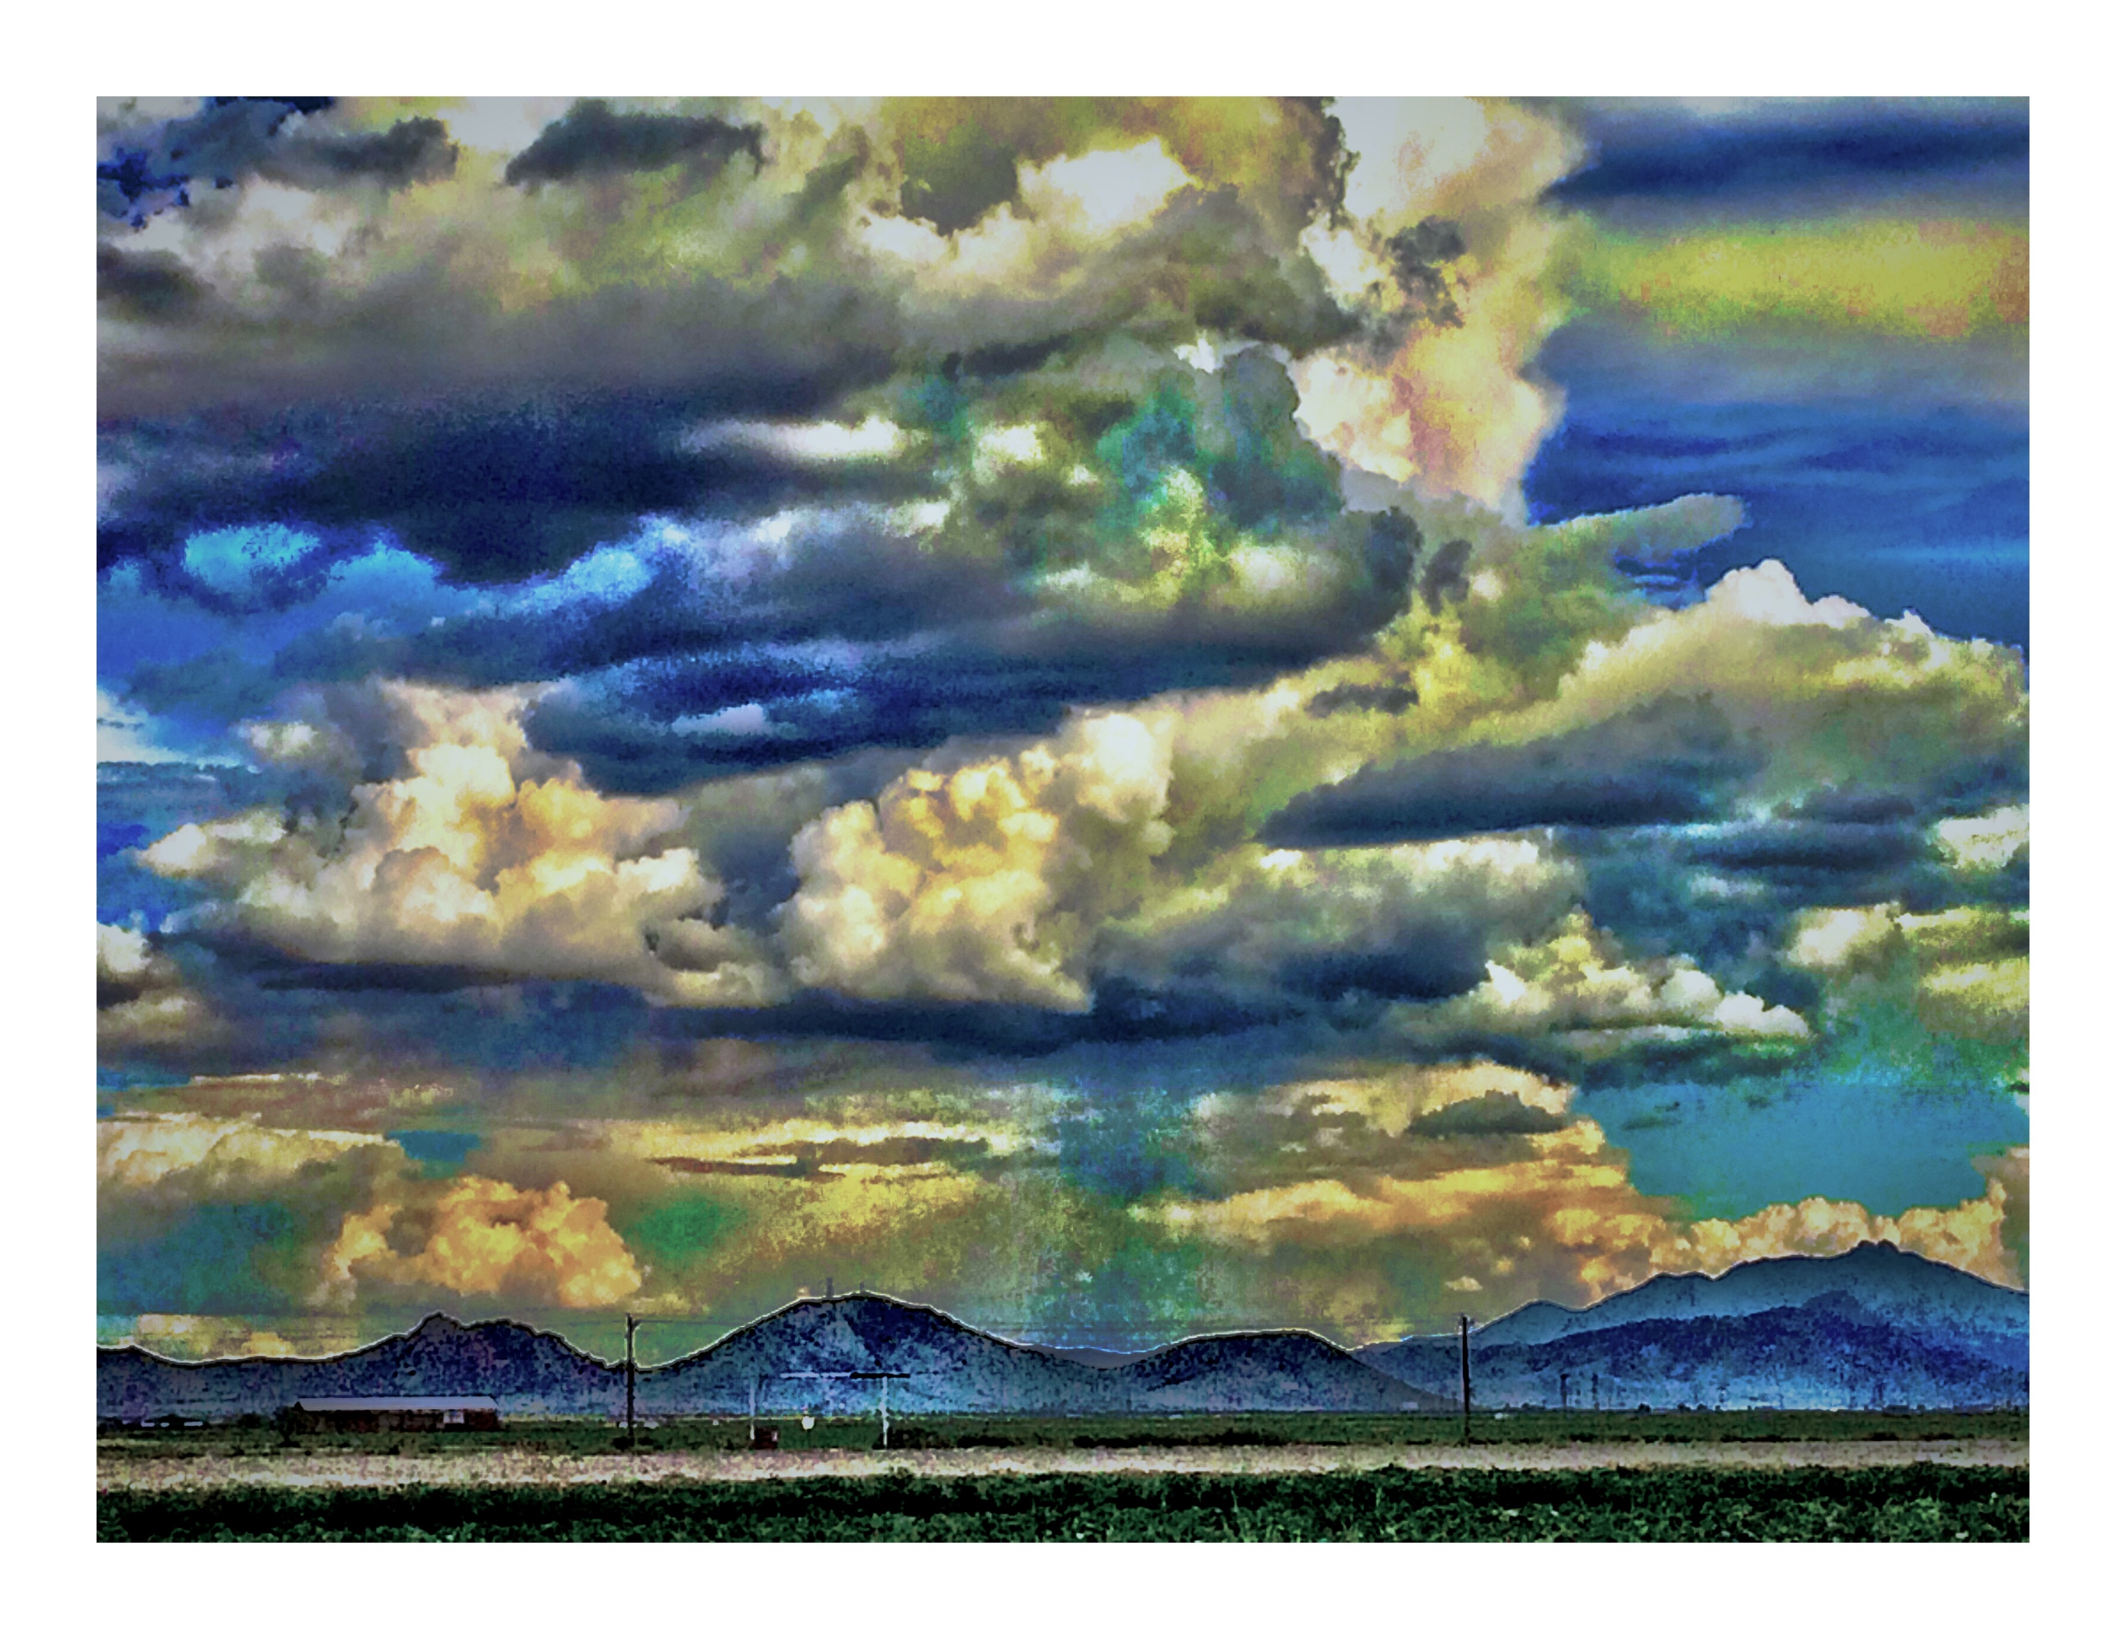
THANK YOU

